Slide 1


Global CO2 Emissions Dashboard Overview
This presentation provides a comprehensive overview of global CO2 emissions, a critical factor driving climate change. We'll delve into historical trends, explore the major contributors to emissions, examine regional disparities, and discuss the urgent need for action. Our focus is on the period from 1990 to 2018, a critical period for understanding the trajectory of greenhouse gas emissions and their impact on the planet. The data presented in this dashboard highlights the pressing need for immediate and effective climate change mitigation strategies.
by Salman Faris

Slide 2
Total CO2 Emissions (1990-2018)
Global CO2 emissions have been steadily rising since 1990, reaching a staggering 996.38 kilotons in 2018. This trend underscores the urgent need to address the climate crisis. The increasing reliance on fossil fuels for energy production, industrial processes, and transportation is the primary driver of this surge in CO2 emissions. The consequences of unchecked emissions include rising global temperatures, sea level rise, and increasingly severe weather events, all of which pose significant risks to human health and the environment.
1990
Global CO2 emissions stood at 731.37 kilotons in 1990, a significant increase from the previous decade.
2010
In 2010, global CO2 emissions crossed the 900 kiloton mark, reaching 914.45 kilotons.
1
2
3
4
2000
2018
By the year 2000, CO2 emissions had reached 816.72 kilotons, demonstrating a continued upward trend.
The latest data from 2018 shows that CO2 emissions reached a record high of 996.38 kilotons, highlighting the urgent need for action.

Slide 3
Total Greenhouse Gas Emissions
While CO2 is the most prevalent greenhouse gas, other gases also play a significant role in climate change. These include methane, nitrous oxide, and fluorinated gases. The combined total greenhouse gas emissions reached 1.36 million metric tons in 2018, demonstrating the magnitude of the challenge. While CO2 makes up the largest share, other greenhouse gases contribute significantly to the warming effect, highlighting the need for comprehensive mitigation efforts. The chart provides a visual representation of the relative contribution of each greenhouse gas, underscoring the importance of addressing all sources of emissions.
1
CO2
2
Methane
Carbon dioxide (CO2) is the most abundant greenhouse gas, primarily generated by the burning of fossil fuels for energy production and transportation. CO2 accounts for approximately 76% of total greenhouse gas emissions.
Methane (CH4) is a potent greenhouse gas produced from sources like livestock, natural gas production, and agriculture. Methane accounts for about 16% of total greenhouse gas emissions.
3
Nitrous Oxide
4
Fluorinated Gases
Nitrous oxide (N2O) is released primarily from agricultural activities, industrial processes, and burning fossil fuels. N2O accounts for about 6% of total greenhouse gas emissions.
Fluorinated gases are synthetic compounds used in various industrial applications. While they are not as abundant as other greenhouse gases, they are extremely potent, contributing to about 2% of total greenhouse gas emissions.

Slide 4

Emissions by Fuel Source
The burning of fossil fuels, particularly coal, oil, and natural gas, is the primary driver of CO2 emissions. Coal combustion is the most significant contributor, accounting for a substantial share of total emissions. Oil, mainly used for transportation, also makes a significant contribution. Natural gas, while often promoted as a cleaner alternative, still contributes to emissions. Notably, cement production, a significant source of CO2 emissions, is often overlooked. The chart provides a clear visual representation of the relative contribution of each fuel source, highlighting the importance of transitioning to cleaner energy alternatives.
Fuel Source
Percentage of Total CO2 Emissions
Coal
40%
Oil
33%
Natural Gas
20%
Cement
7%

Slide 5
Regional CO2 Emissions per Capita
Regional disparities in CO2 emissions per capita are stark. North America and Asia, with their large populations and high levels of industrial activity, have the highest per capita emissions. These regions are home to major economies with significant energy demands, driving their high emissions. Europe, while still having significant emissions, has made notable progress in reducing per capita emissions through policies and investments in renewable energy. The map provides a visual representation of the global distribution of per capita emissions, highlighting the need for collective action to address this issue.
North America
Asia
Europe
North America has the highest per capita CO2 emissions, primarily due to its high energy consumption for transportation, industrial activities, and residential use.
Asia, with its large population and rapid economic growth, also has high per capita CO2 emissions, driven by industrialization and increasing reliance on fossil fuels for energy.
Europe has made significant progress in reducing per capita CO2 emissions through investments in renewable energy, energy efficiency measures, and policies promoting sustainable practices.

Slide 6



Correlation Between CO2 and Temperature
The correlation between rising CO2 levels and increasing global temperatures is undeniable. The data shows a strong positive correlation, with higher CO2 levels consistently associated with higher global temperatures. This relationship highlights the direct impact of greenhouse gas emissions on the planet's climate system. The scatter plot provides a visual representation of this correlation, underscoring the urgent need to address CO2 emissions and mitigate climate change. The long-term trend shows a clear upward trajectory for both CO2 concentrations and global temperatures, reinforcing the strong connection between these factors.
Increased CO2 Levels
Greenhouse Effect
Climate Change
As CO2 emissions from human activities rise, the concentration of this greenhouse gas in the atmosphere increases.
CO2 traps heat in the atmosphere, leading to an enhanced greenhouse effect, resulting in higher global temperatures.
The increased greenhouse effect drives climate change, manifesting in various ways, including rising sea levels, more frequent and intense extreme weather events, and changes in precipitation patterns.

Slide 7




Urgent Need for Emissions Reduction
The data presented clearly demonstrates the urgent need for significant reductions in greenhouse gas emissions. Failing to act will lead to irreversible and catastrophic consequences for the planet and its inhabitants. Rising sea levels, extreme weather events, and disruptions to ecosystems are already being observed, and these impacts are projected to intensify if emissions continue unchecked. The urgency of the situation necessitates immediate and collaborative action from governments, businesses, and individuals.
Climate Change
Rising Temperatures
Sea Level Rise
Extreme Weather Events
Climate change is a complex and multifaceted issue with far-reaching impacts on human society and the natural world.
Global average temperatures are rising due to the increasing concentration of greenhouse gases in the atmosphere.
As global temperatures rise, ice sheets and glaciers melt, contributing to rising sea levels, posing a threat to coastal communities.
Climate change is increasing the frequency and intensity of extreme weather events, including hurricanes, droughts, floods, and wildfires.

Slide 8
Strategies for Climate Change Mitigation
Addressing climate change requires a multi-pronged approach involving technological advancements, policy changes, and behavioral shifts. Transitioning to renewable energy sources is paramount, reducing reliance on fossil fuels. Developing and deploying carbon capture and storage technologies can help mitigate emissions from existing industrial processes. Promoting energy efficiency measures in homes, businesses, and transportation can significantly reduce energy consumption and emissions. These efforts necessitate collaborations between governments, businesses, and individuals to create a sustainable future.
Renewable Energy
Energy Efficiency
Investing in renewable energy sources like solar, wind, and hydro power can significantly reduce greenhouse gas emissions.
Improving energy efficiency in homes, businesses, and transportation systems can reduce energy consumption and emissions.
Carbon Capture and Storage
Sustainable Transportation
Developing and deploying technologies to capture and store carbon dioxide from industrial processes can help mitigate emissions.
Shifting towards electric vehicles, public transportation, and active modes of transport can reduce reliance on fossil fuels.

Slide 9

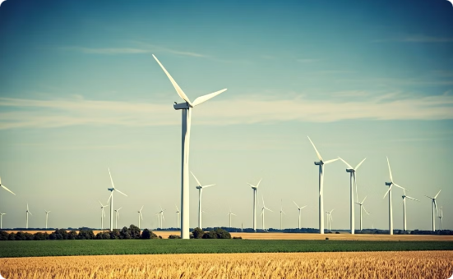

Transitioning to Renewable Energy
The transition to a renewable energy future is essential for mitigating climate change. Investing in research and development of renewable energy technologies, including solar, wind, hydro, and geothermal, will be crucial. Policy changes, such as tax incentives and subsidies, can encourage investments in renewable energy infrastructure. Additionally, promoting energy efficiency and reducing energy waste are critical components of a successful transition to renewable energy.
Solar Energy
Wind Energy
Hydropower
Solar energy harnesses the power of the sun to generate electricity, offering a clean and sustainable energy source.
Wind energy utilizes the power of wind to generate electricity, providing a reliable and environmentally friendly energy source.
Hydropower utilizes the flow of water to generate electricity, providing a clean and reliable energy source, particularly in regions with abundant water resources.

Slide 10

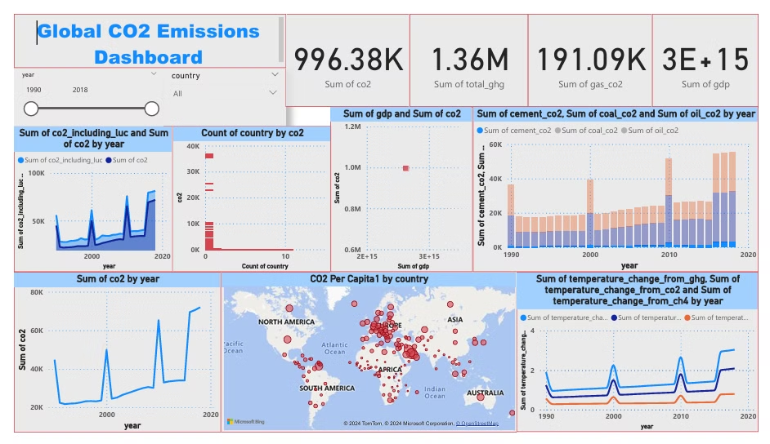
Conclusion and Call to Action
Addressing climate change requires immediate and collective action. The data presented highlights the urgent need for a global shift towards sustainable practices. Governments must implement policies that incentivize renewable energy, promote energy efficiency, and regulate emissions. Businesses must adopt sustainable practices, reduce their carbon footprints, and invest in renewable energy technologies. Individuals can make a difference by making informed choices about energy consumption, transportation, and waste management. By working together, we can mitigate climate change and secure a sustainable future for generations to come.

